Slide 1
Exploring the effects of aging on brain endothelial cells
26 July 2022

Slide 2
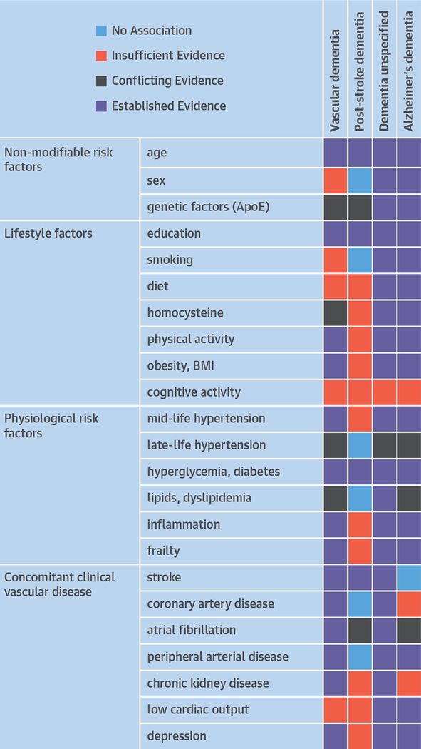
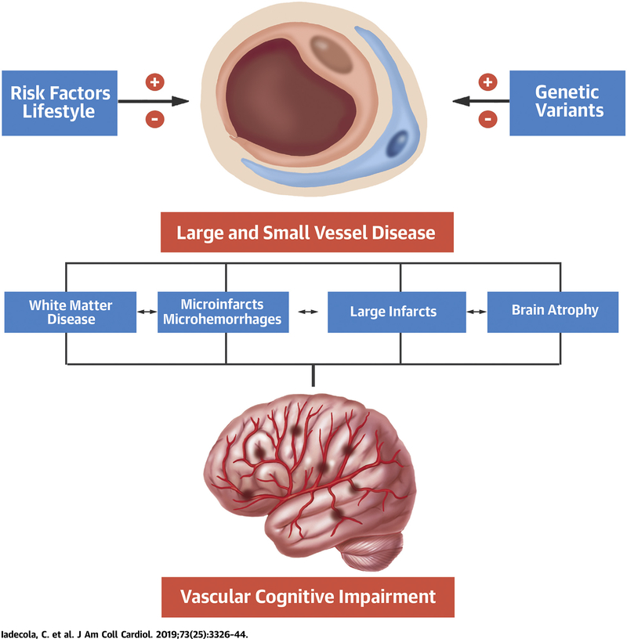
Aging: A major risk factor for vascular dementia (VaD)
The second most common cause of dementia after Alzheimer's disease
May be the predominant one in East Asia
Advancing age is the main risk factor
The anticipated “dementia epidemic” might lead to devastating socioeconomic impact
Cerebrovascular disease, both symptomatic and asymptomatic, is a powerful risk factor for VaD

Slide 3
What are the known effects of aging on brain endothelial cells (BEC)
A critical consequence of dysfunctional BECs is increased in BBB permeability, which could be through
eNOS/NO signalling dysregulation and loss/redistribution of tight junction proteins
increase levels of pro- inflammatory immune cells
increase ratio of senescent BECs
A global decrease in cerebral blood flow, thus causing cerebral hypoperfusion, are seen in both normal aging and disease-associated neurodegeneration.
Notes:
BEC dysfunction occurs during both normative ageing and during cerebrovascular disease, but the mechanisms behind this impaired function are not well-characterized.

Slide 4
Research gap/ questions
The consequence of aging on the functional heterogeneity of BEC
→ A deeper understanding of the pathobiology.
Investigate cognitive effects of neurovascular function, especially endothelial function
Signature of BEC dysfunction (as a consequence of aging)
→ Reliable biomarkers
Although BBB dysfunction may be an early marker of disease
Contribution of BBB leakage to brain damage need to be validated further to define its role as a biomarker
Vascular factors causing cognitive impairments needed to be study more extensive
Most cognitive impairment in the elderly arises from multiple pathologies of which the vascular component is currently the only treatable and preventable one.
Iadecola C, Duering M, Hachinski V, Joutel A, Pendlebury ST, Schneider JA, Dichgans M. Vascular Cognitive Impairment and Dementia: JACC Scientific Expert Panel. J Am Coll Cardiol. 2019 Jul 2;73(25):3326-3344. doi: 10.1016/j.jacc.2019.04.034. PMID: 31248555; PMCID: PMC6719789.

Slide 5

Single-cell RNA sequencing analysis on mouse cortex dataset
Open-source data/ Paper
Tabula Muris Senis Dataset
A single-cell transcriptomic atlas characterizes ageing tissues in the mouse (2020)
18 organs (many sub-tissues). The brain was dissected into cerebellum, cortex, hippocampus and striatum → process separately
Animal subjects
Male and female mice of three age groups
3-month: 3 male, 1 female 18-month: 2 male, 2 female 24-month: 1 male
Cortex only
Single-cell RNA-seq dataset
22,966 genes x 2,767 cells

Slide 6
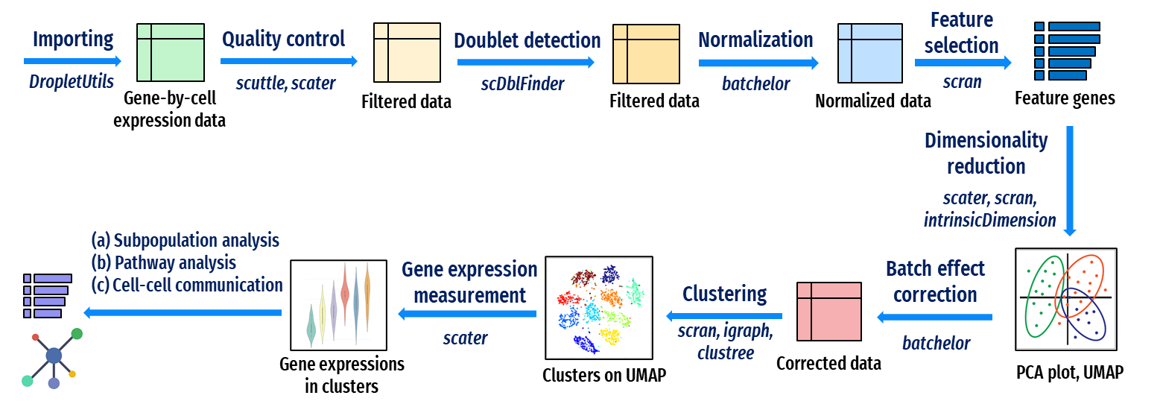
scRNAseq analysis with R

Slide 7
Quality control

Slide 8
Quality control

Slide 9
Clustering
Notes:
Maybe change color?

Slide 10
Endothelial cells markers
Notes:
Cortex

Slide 11
Annotation
Notes:
Cortex

Slide 12
Change in percentage of cell type
Notes:
Cortex
P-value <0.0001 (****)
Look for artifacts sign??? OLG,astr,
Proliferate
Wtn

Slide 13
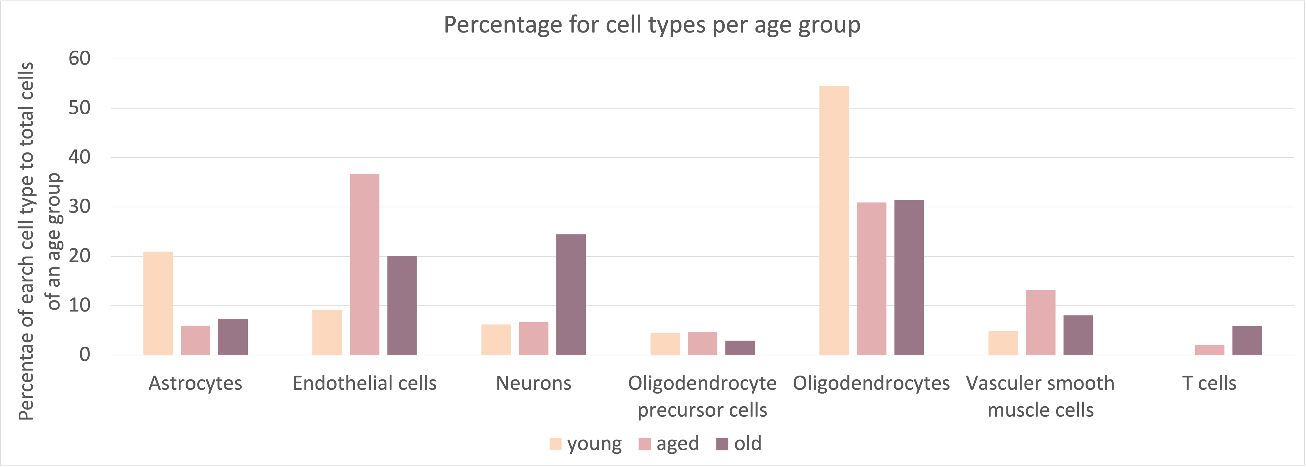
Change in percentage of cell type
Notes:
Cortex
P-value <0.0001 (****)
Look for artifacts sign??? OLG,astr,
Proliferate
Wtn

Slide 14
Brain endothelial cells

Slide 15
Unsupervised clustered BEC subclusters
Notes:
Cortex

Slide 16
ECM-Reorganizing BEC
Pathway enrich with top 200 highest FC, pval<0.01, qval<0.05
Notes:
Cortex, top 200 highest FC (100 cannot differentiate between subclusters)
p=0.01
q=0.05

Slide 17
Migrating-Angiogenic BEC
Pathway enrich with top 200 highest FC, pval<0.01, qval<0.05
Notes:
Cortex, top 200 highest FC (100 cannot differentiate between subclusters)
p=0.01
q=0.05

Slide 18
Transporting BEC
Pathway enrich with top 200 highest FC, pval<0.01, qval<0.05
Notes:
Cortex, top 200 highest FC (100 cannot differentiate between subclusters)
p=0.01
q=0.05

Slide 19
Change in percentage of BEC subclusters
Notes:
Cortex
P value = 0.2580 (ns)
Old increase in migrative BEC, transporting BEC and decrease in OXPHOS

Slide 20
Change in percentage of BEC subclusters
Notes:
Cortex
P value = 0.2580 (ns)
Old increase in migrative BEC, transporting BEC and decrease in OXPHOS

Slide 21
Arteriovenous axis BEC subclusters
Notes:
Cortex, assign cells to groups from published markers

Slide 22
Notes:
Cortex
P value = 0.0005 (***)
Old increase avEC, vcap EC, (aEC2); decrease in capEC, vEC, (aEC1)

Slide 24
Notes:
Cortex young

Slide 25
Notes:
Cortex
P value <0.0001 (****)

Slide 26
aEC1
aEC2
avEC
Significant DEGs (blue): p-val<0.05 and |FC|>1.5
176
29
219
36
8
53
capEC
vcapEC
vEC
197
595
484
0
0
41

